Slide 1
Telecom Churn Case study
By J.Lohith Sai

Slide 2
Contents
Problem Statement
Plan of Action
EDA Corelations
Observation
Conclusions

Slide 3
Problem Statement & Business objective
In the telecom industry, customers are able to choose from multiple service providers and actively switch from one operator to another. In this highly competitive market, the telecommunications industry experiences an average of 15-25% annual churn rate. Given the fact that it costs 5-10 times more to acquire a new customer than to retain an existing one, customer retention has now become even more important than customer acquisition.
Objective: To reduce customer churn, telecom companies need to predict which customers are at high risk of churn.

Slide 4
PLAN OF ACTION
Importing the data and inspecting the data frame
Data preparation
EDA
Test-Train split
Feature scaling
Correlations
Model Building
Model Evaluation
Making predictions on test

Slide 5
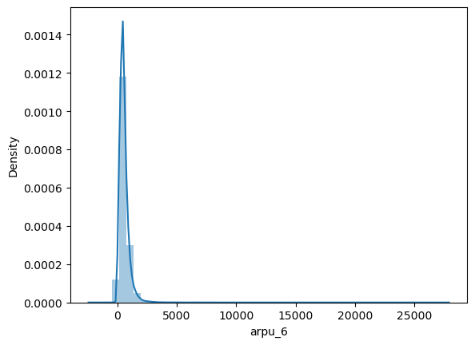
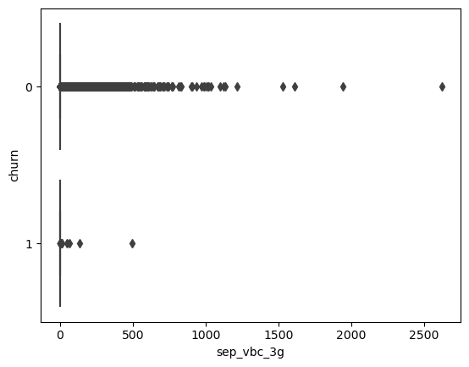
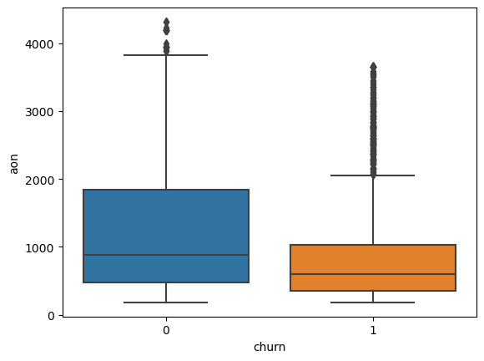
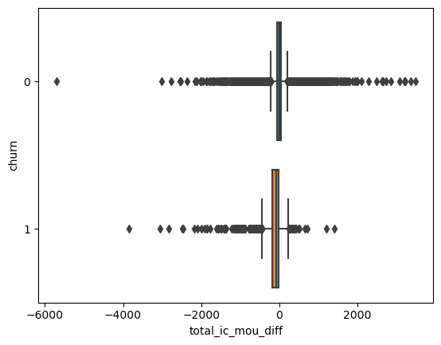
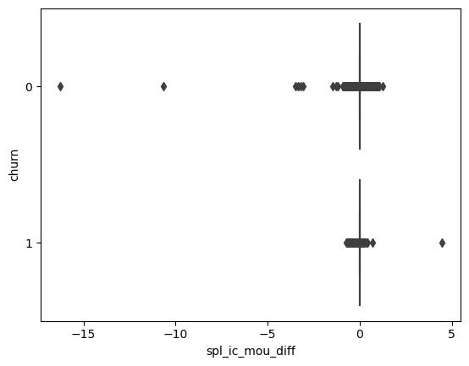
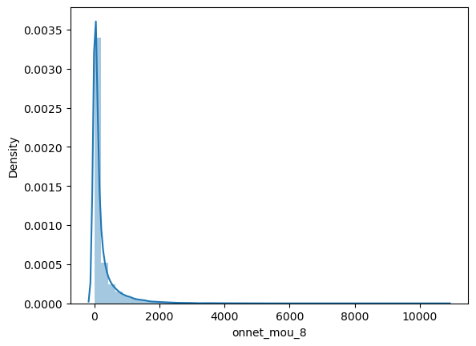
EDA Corelations

Slide 6
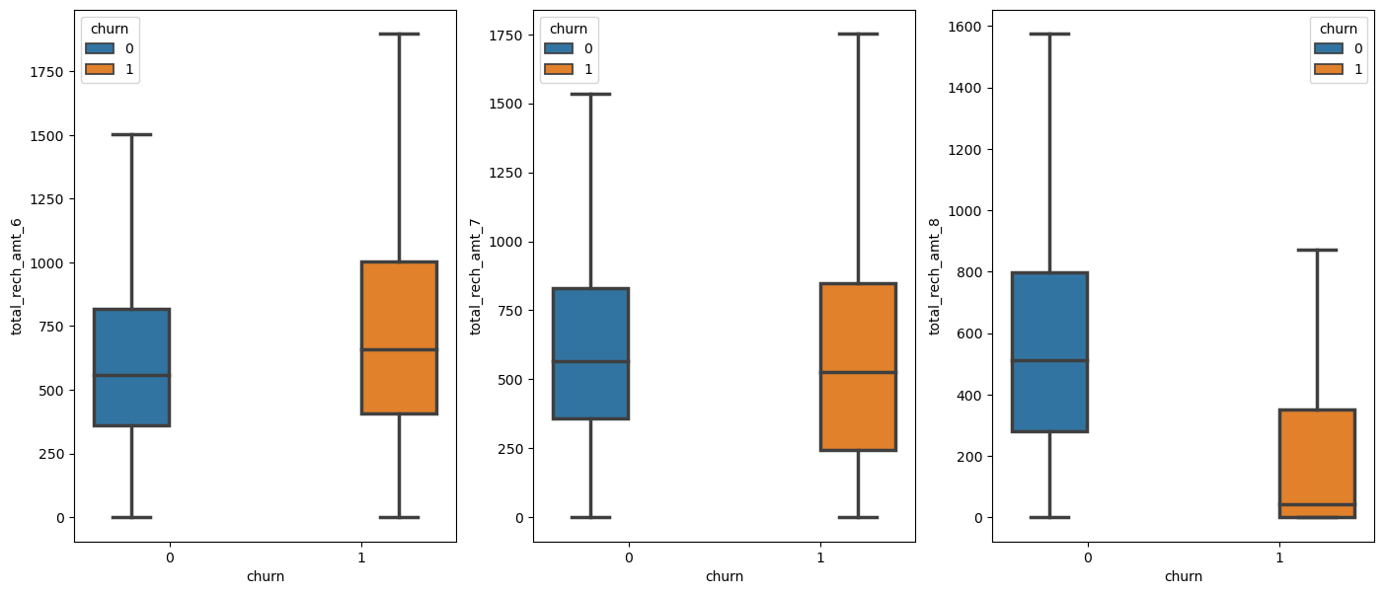
Seeing the total recharge amount in the three months

Slide 7
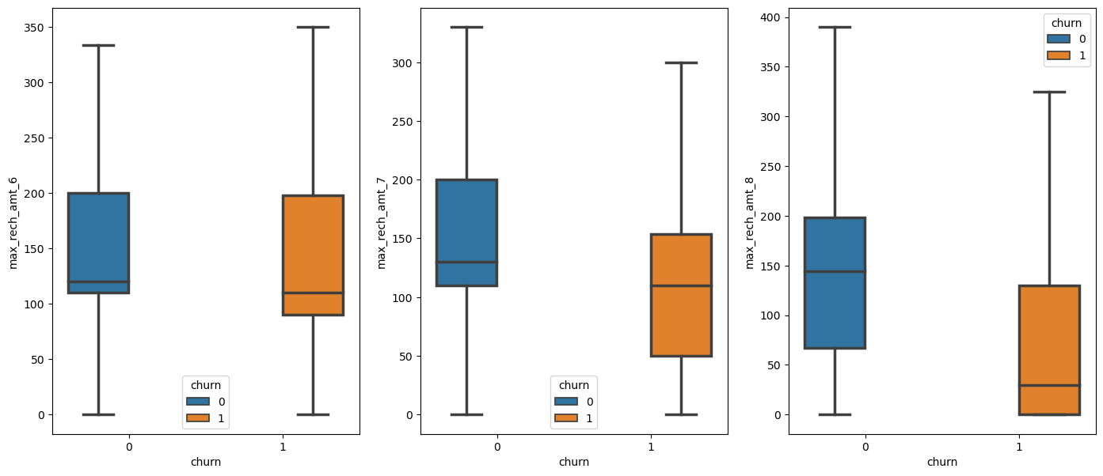
Differentiating the max recharge amount

Slide 8
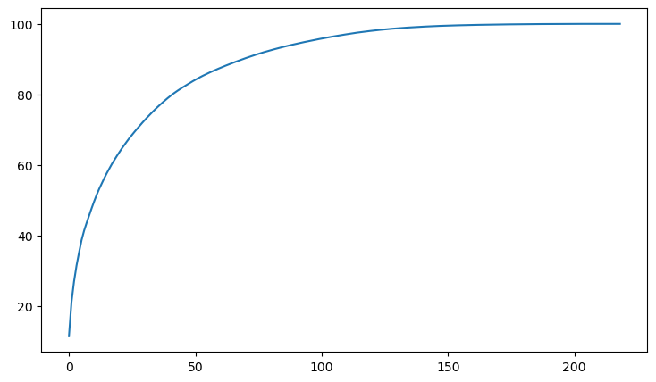
Cumulative Variance

Slide 9
Observations
Train Data
Test Data
Pipeline Score : 96%
Model Best Score : 99%
Random Forest model score : 99%
Accuracy : 90%
Sensitivity : 99%
Specificity : 95%
ROC : 99
Pipeline Score : 96%
Model Best Score : 99%
Random Forest model score : 99%
Accuracy : 90%
Sensitivity : 84%
Specificity : 88%
ROC : 88%

Slide 10
Conclusion
We see that the conversion rate is 30-35% (close to average) for churning of the customers so the telecom industry should focus on these steps for the customer retention. These can help to retend the high values customers
Steps to help reduce churn
Give special; discounts to customers according to their usage
Provide additional internet services on recharge.
Speak to customers to fulfil their desires.
Lower tariffs on data usage, better 2G area coverage where 3G is not available.
Expansion of 3G network where 3G is currently not available.

